Slide 1

Multi-Region AWS Infrastructure with CI/CD, EKS, and RDS
Secure, Resilient, Multi-Region Deployment on AWS
by Ashutosh Sanghi

Slide 2

Project Overview: Dual-Region Infrastructure
CloudFormation & Terraform Synergy
Identical infrastructure deployed across two AWS regions. CloudFormation manages one region, Terraform handles the other.
Core Services Integration
Leveraging Amazon EKS for container orchestration and RDS for managed database services in both regions.
CI/CD for Automation
Automated deployment pipelines for both infrastructure and application code, ensuring consistency and speed.

Slide 3
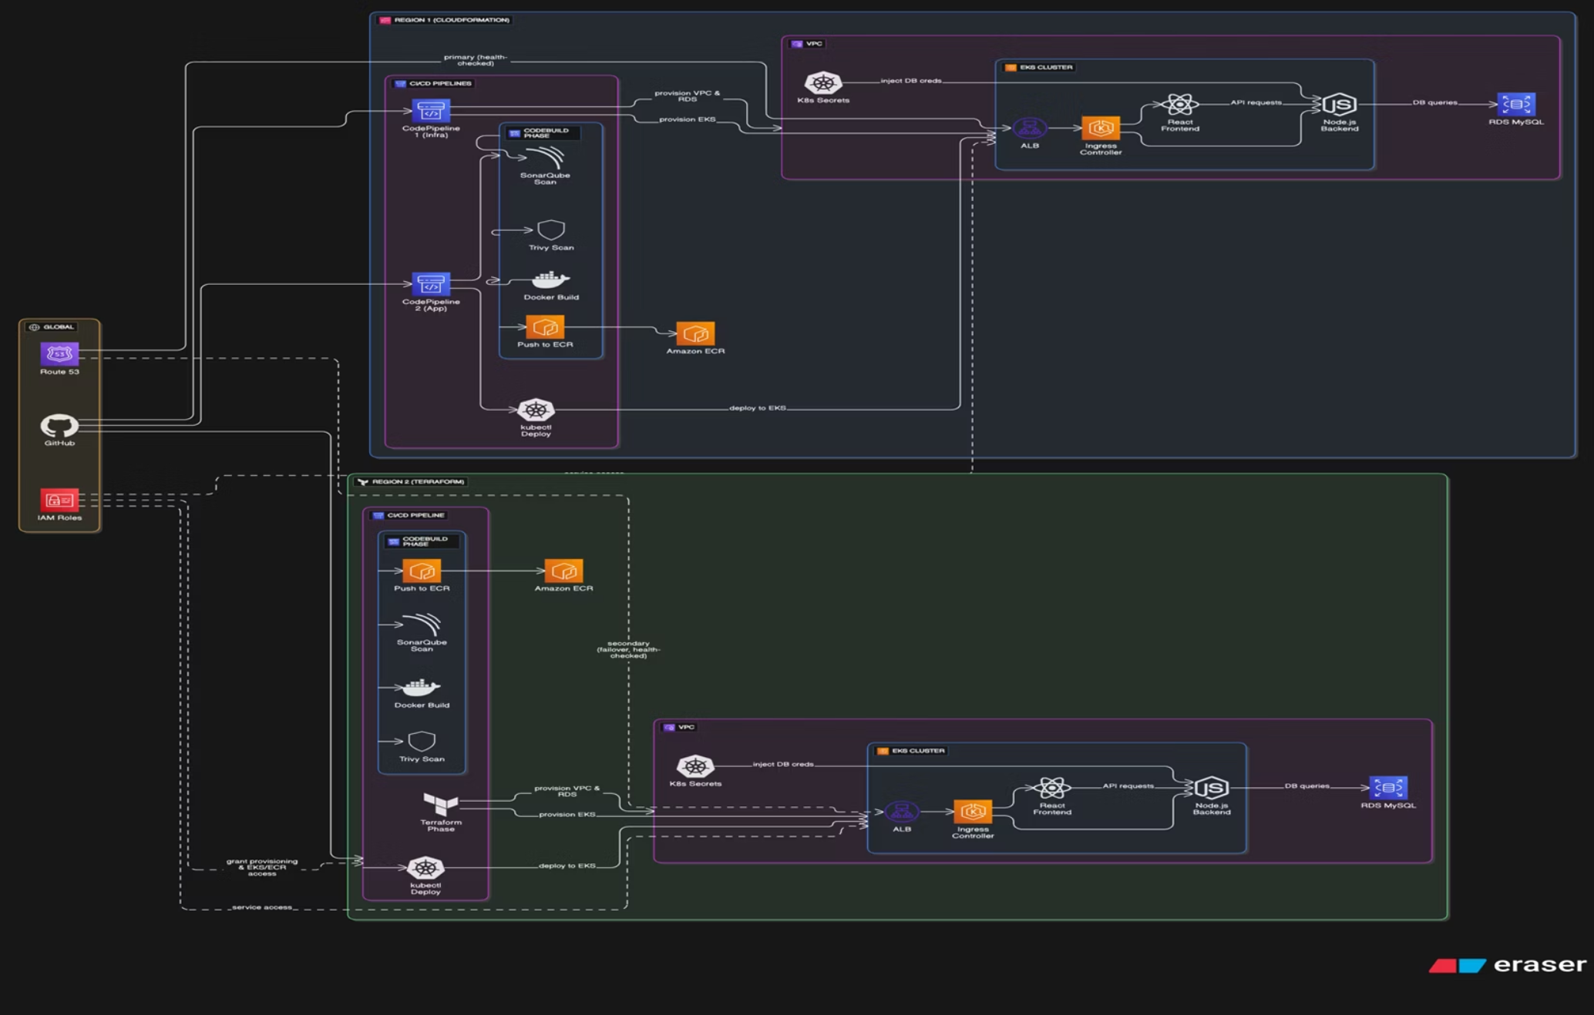
Architecture Diagram: High Availability Across Regions
This diagram illustrates the synchronized deployment across two distinct AWS regions, ensuring high availability and disaster recovery through mirrored infrastructure and intelligent Route 53 failover routing.

Slide 4
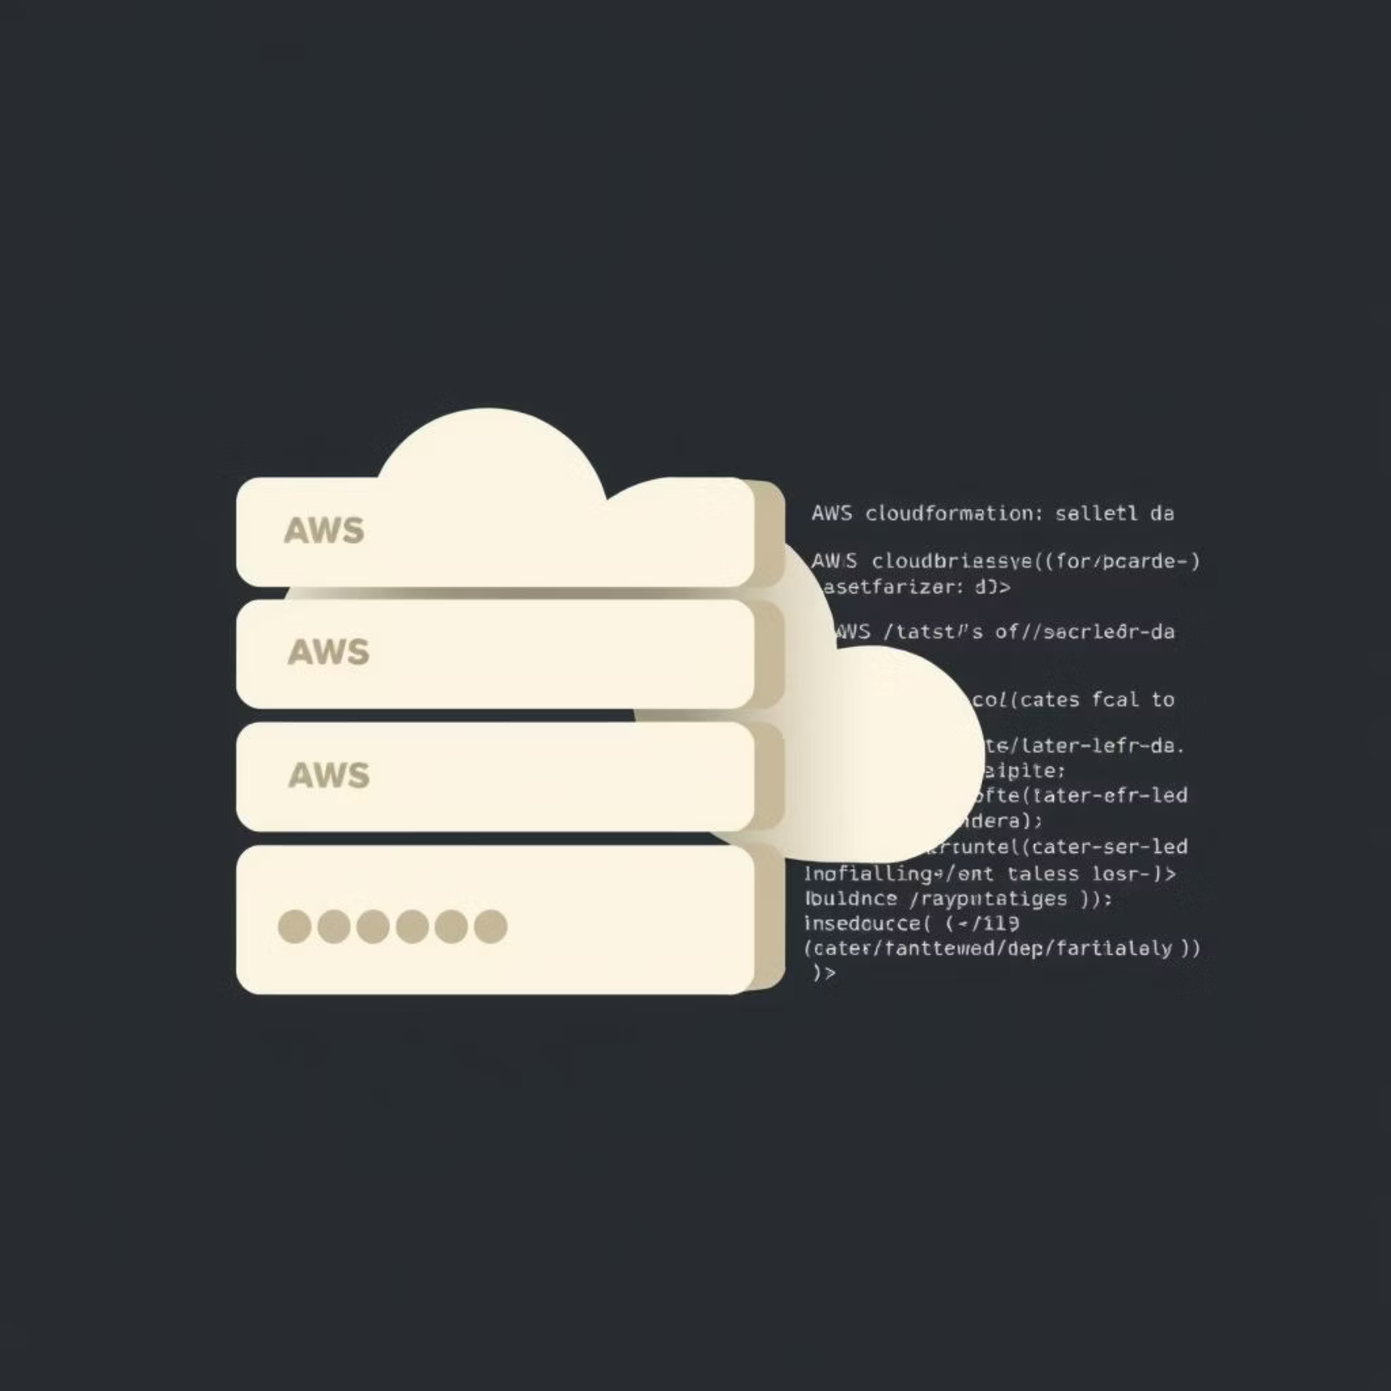
CloudFormation Region: Infrastructure as Code
VPC Network Setup
Configured with private and public subnets, NAT Gateways, and security groups for robust isolation.
EKS Cluster Provisioning
Automated deployment of EKS cluster and worker nodes, ready for containerized applications.
RDS MySQL Deployment
Managed MySQL database instances with multi-AZ for high availability, securely integrated within the VPC.
CodePipeline Integration
Application deployment managed through AWS CodePipeline, orchestrating builds and deployments.

Slide 5
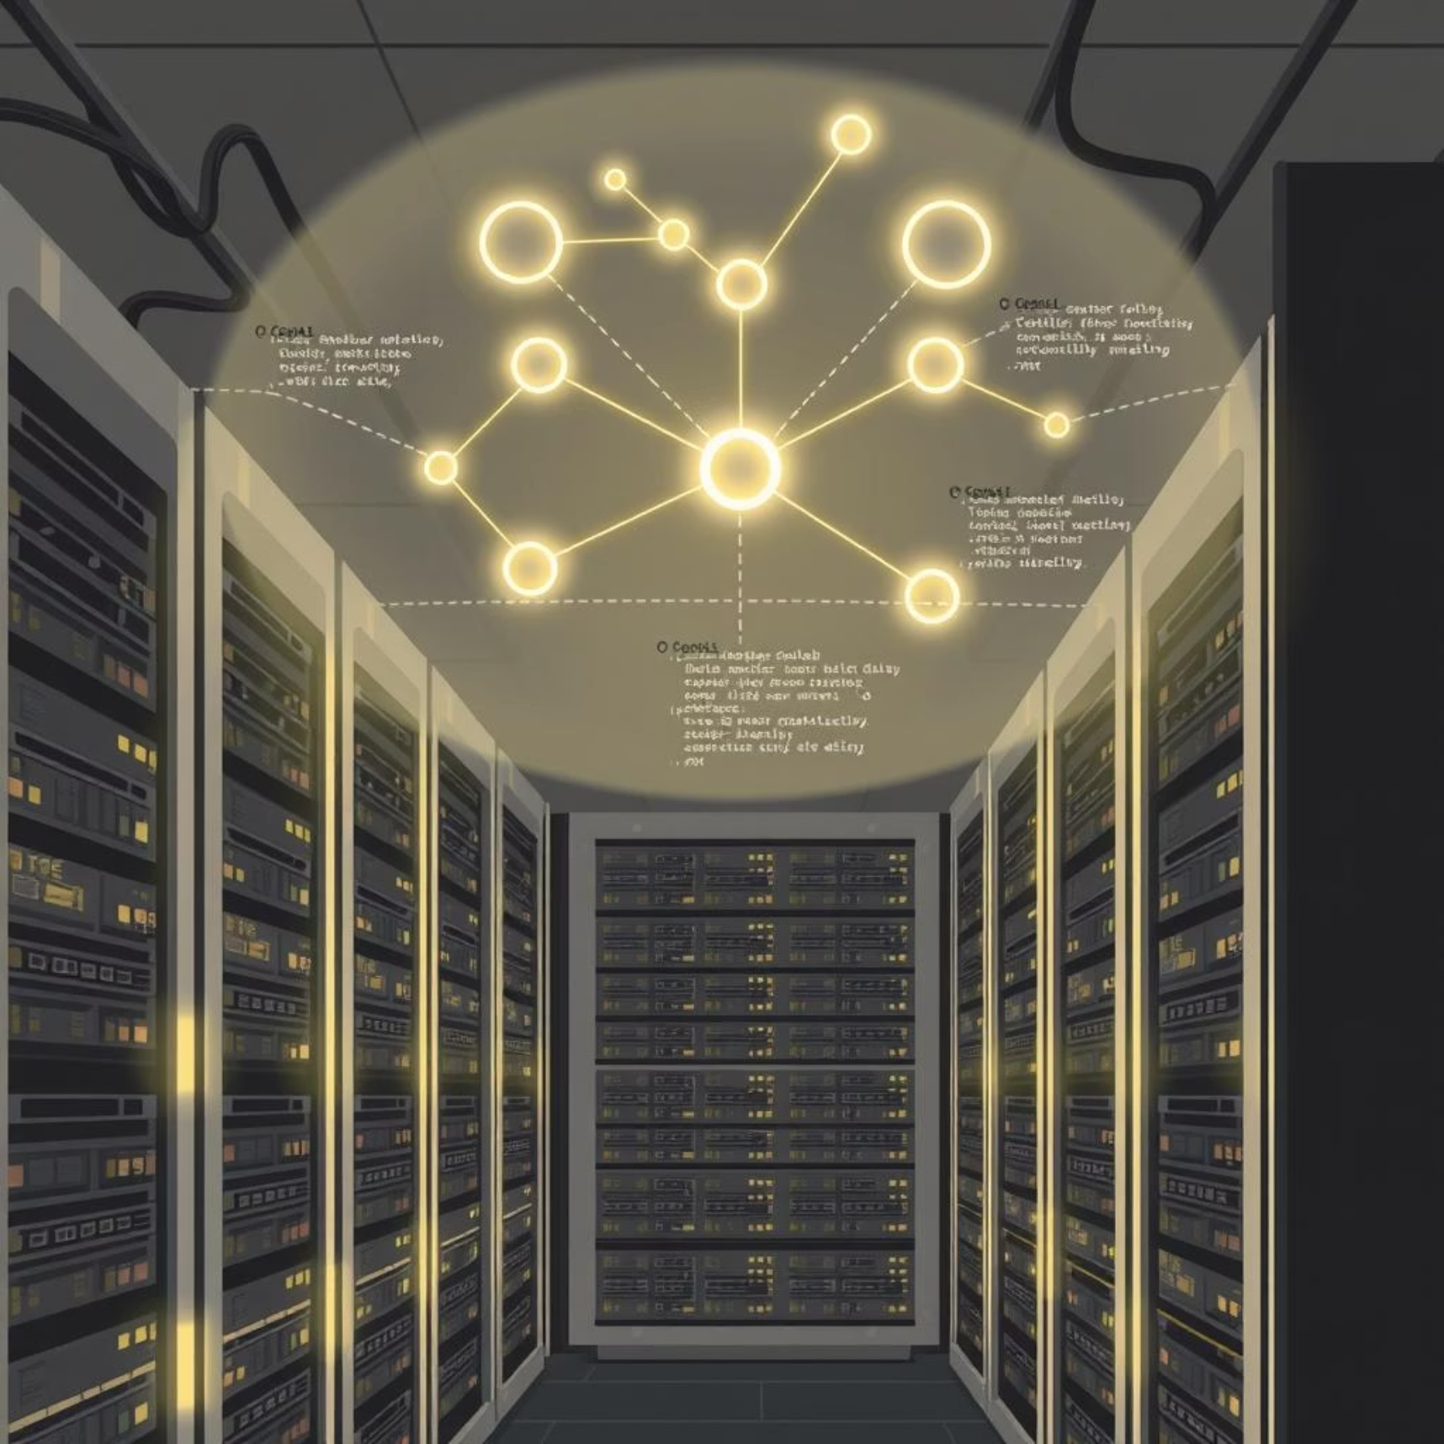
Terraform Region: Declarative Infrastructure
VPC & Networking
Terraform provisions an identical VPC structure, ensuring consistent network configuration across regions.
EKS Cluster Setup
Orchestrates the EKS cluster, node groups, and necessary IAM roles for seamless operation.
RDS Instance Replication
Deploys a mirror RDS MySQL instance with backup and recovery configurations, ensuring data integrity.
CodePipeline Alignment
Maintains a parallel CodePipeline flow for application updates, ensuring symmetry with the CloudFormation region.

Slide 6
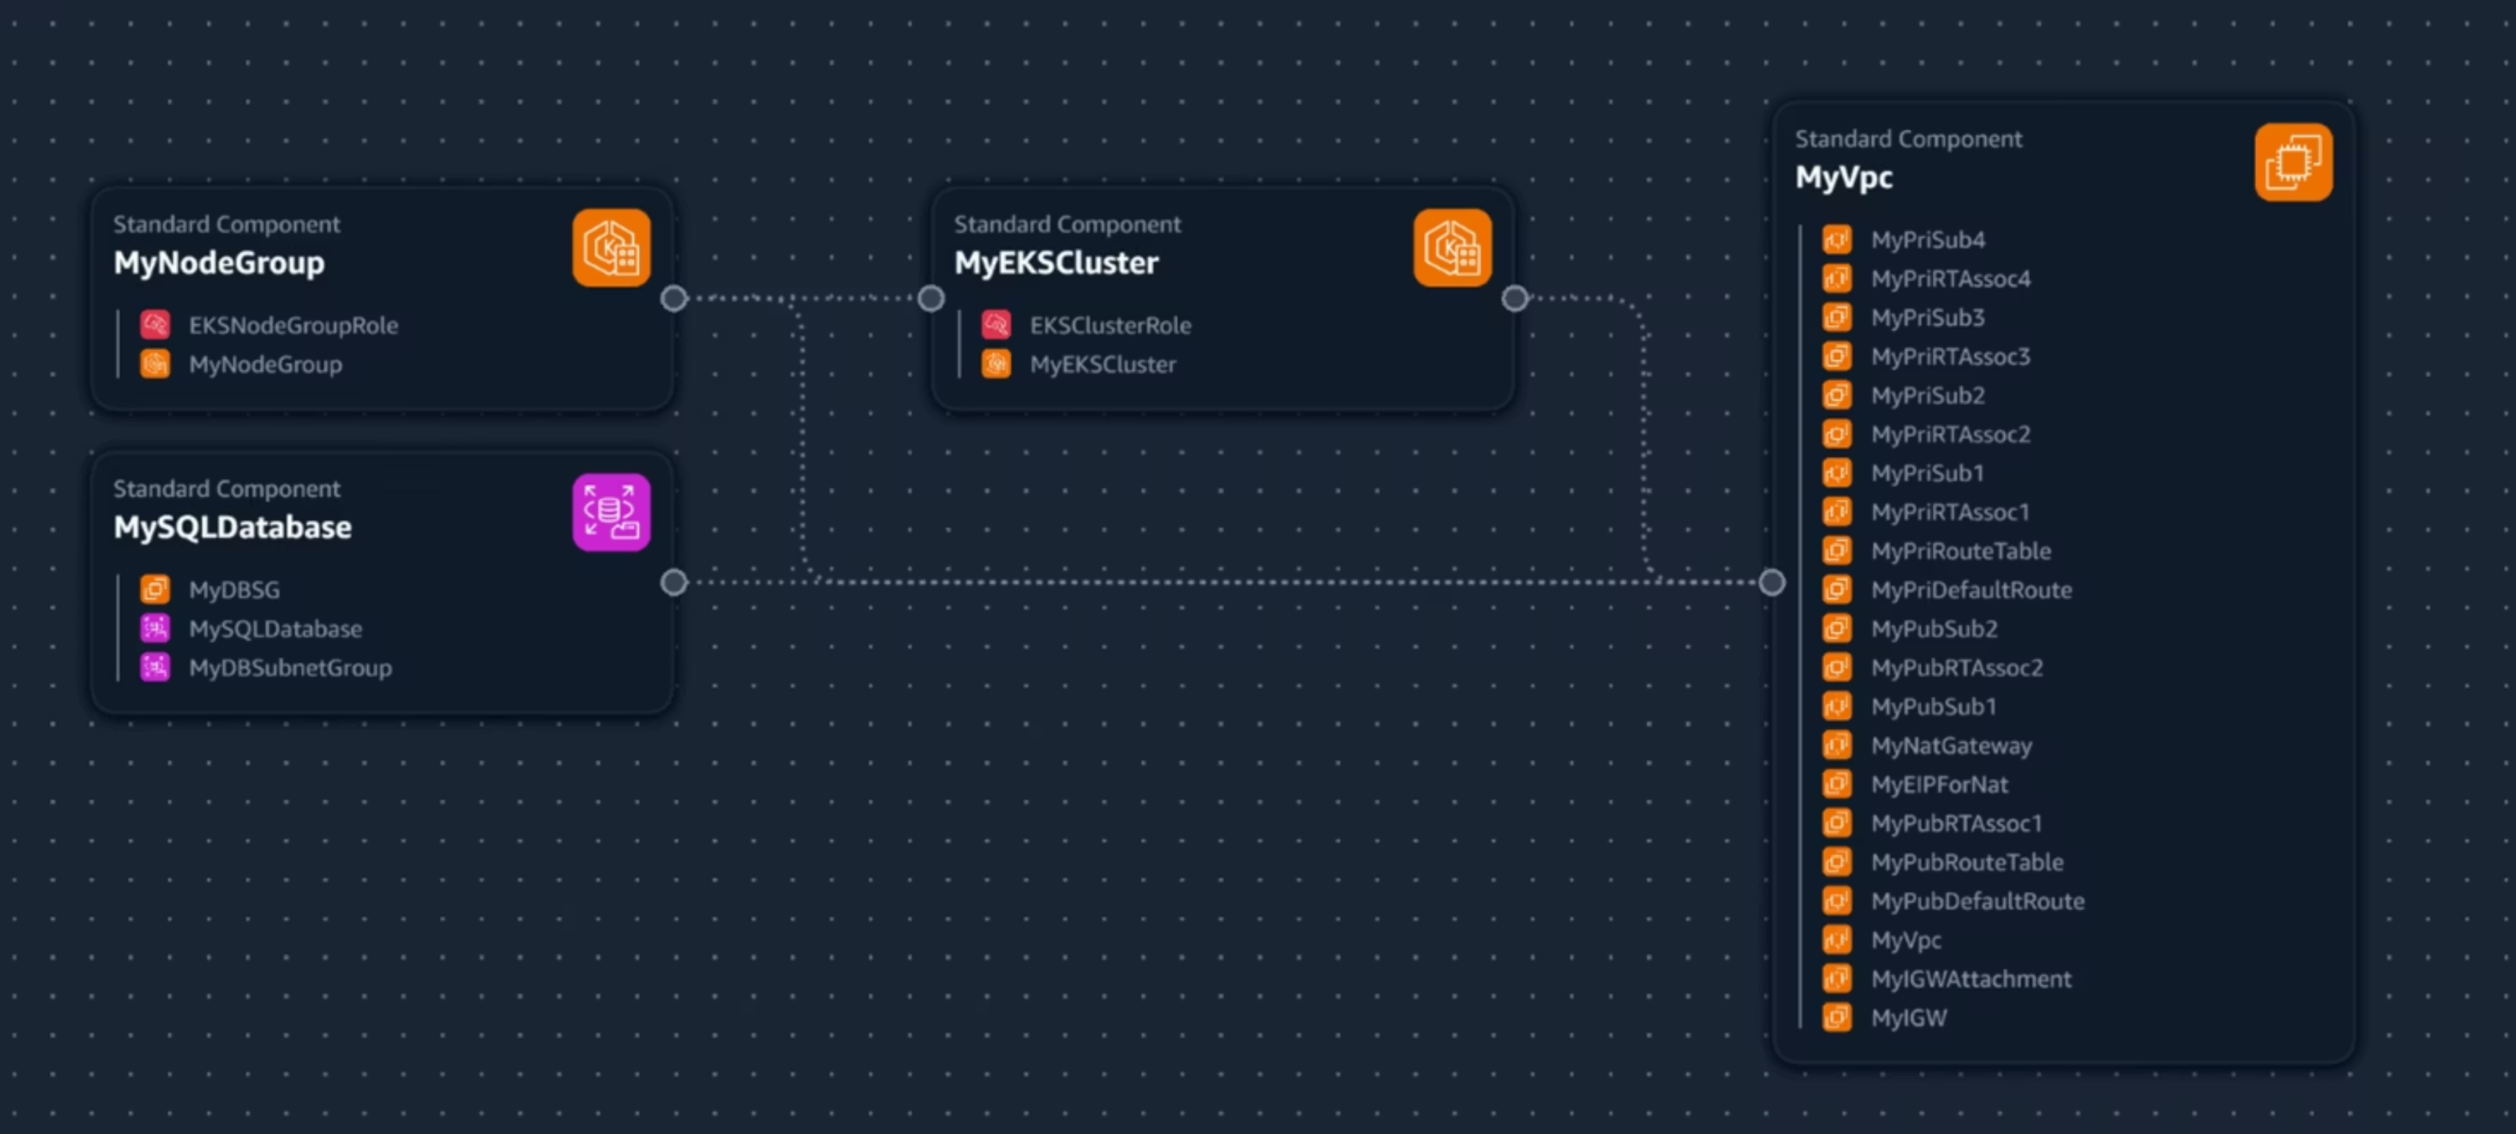
INFRA TEMPLATE

Slide 7

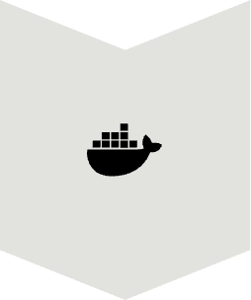
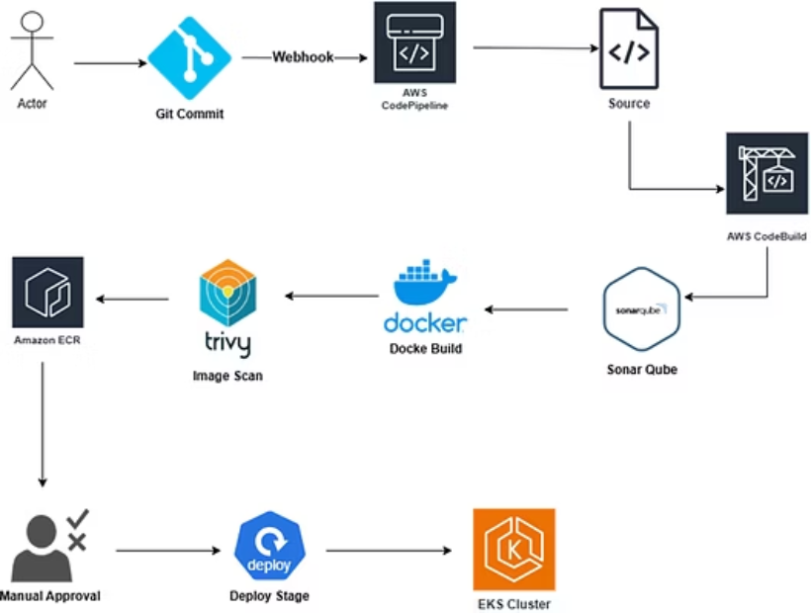
CI/CD Pipelines: Automated & Secure Deployments
Infrastructure Pipeline
Automates provisioning and updates for CloudFormation and Terraform stacks in respective regions.
Application Pipeline
Integrates SonarQube for code quality, Trivy for container vulnerability scanning, ECR for image storage, and EKS for deployment.

Slide 8





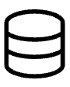
3-Tier Application Architecture
Node.js Backend
Robust API layer handling business logic and data processing.
React Frontend
User-facing interface, designed for responsiveness and intuitive user experience.
MySQL RDS Database
Reliable and scalable data persistence layer, managed by AWS RDS for high availability.

Slide 9
Route 53 Failover & Conclusion
Automated Failover
Security-First Pipeline
Route 53 configured with health checks for automatic failover to the healthy region, ensuring continuous service.
Integrated SonarQube and Trivy scans enforce code quality and container security at every stage.
Full Automation & Resilience
Key Benefits
Infrastructure and application deployments are fully automated, providing high availability and multi-region resilience.
High availability, enhanced security, full automation, and robust multi-region disaster recovery capabilities.

Slide 10
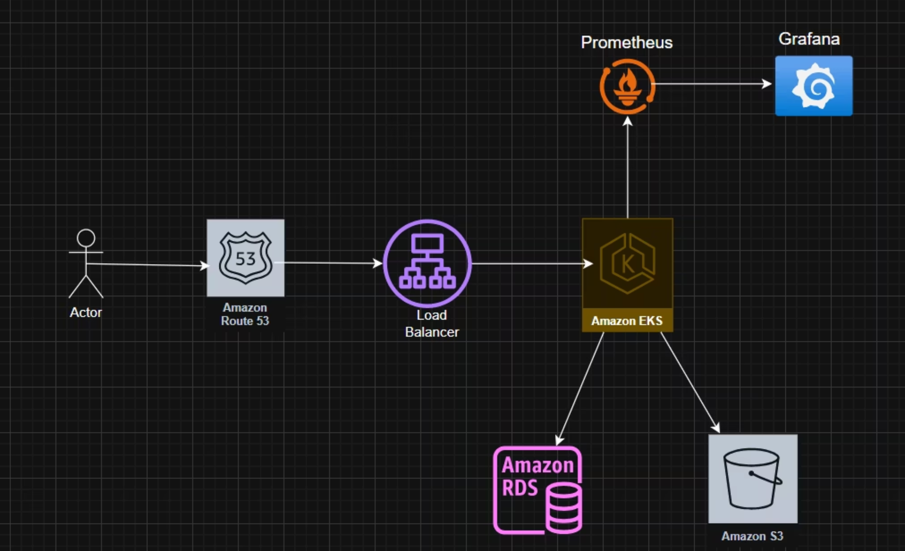
APPLICATION

Slide 11
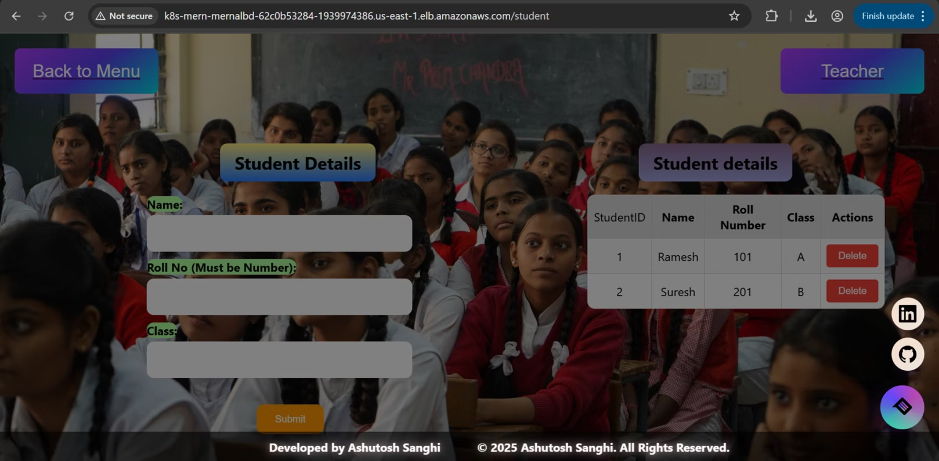
BROWSER ACCESS 1

Slide 12
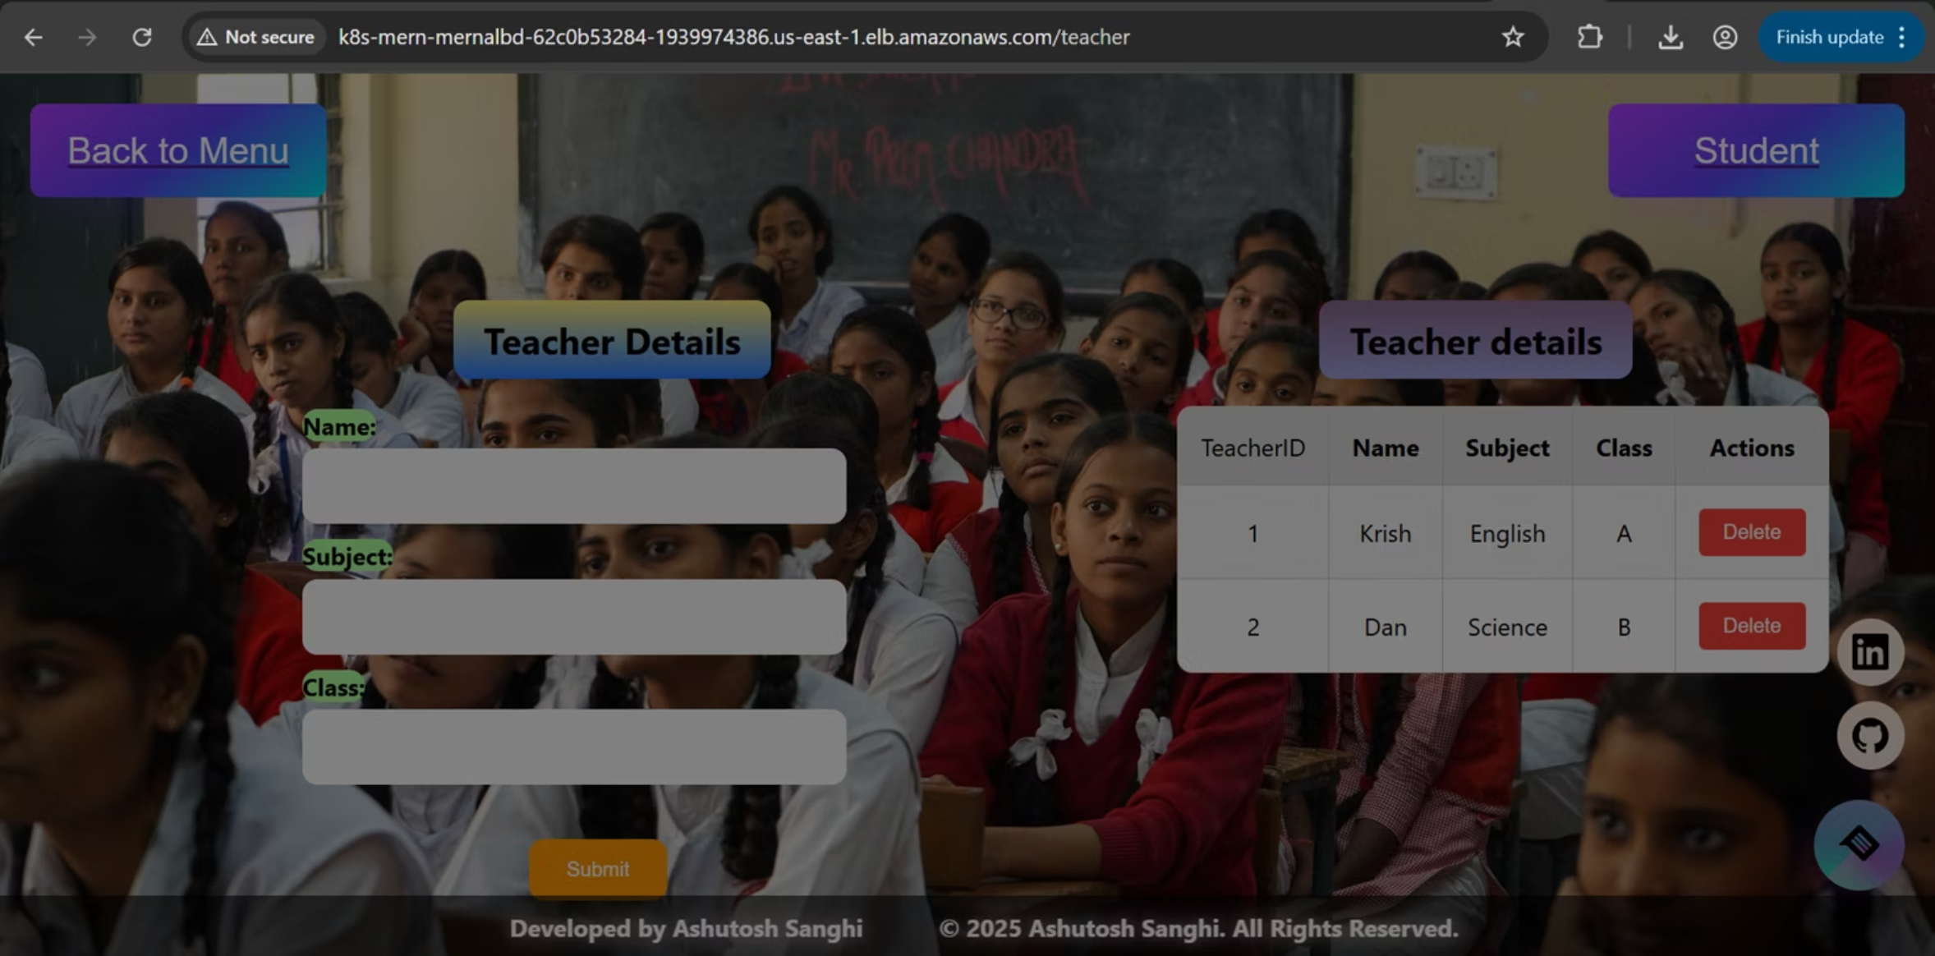
BROWSER ACCESS 2

